Slide 1
Physical Geography of South Asia

Slide 2
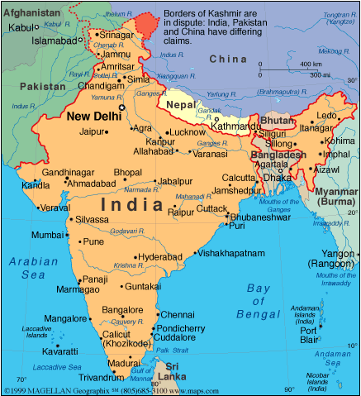
Subcontinent:
A large landmass that is smaller than a continent

Slide 3
Archipelago:
An island group
  Example: The Maldives, consists of more than 1,200 small islands

Slide 4
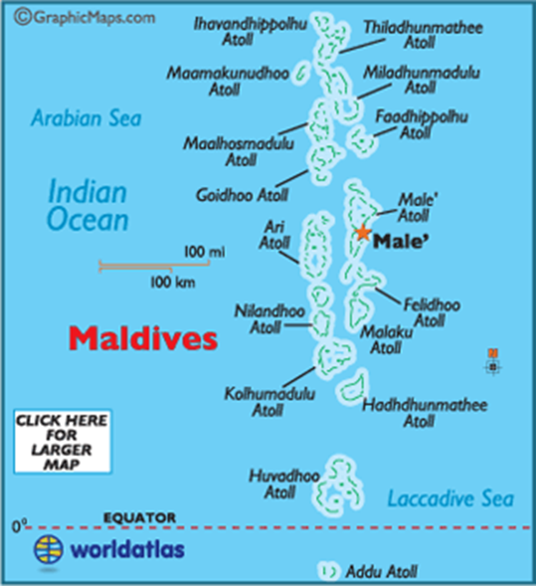

Slide 5
Atoll:
  An island consisting of the low-lying top of a submerged volcano surrounded by coral reefs and/or shallow reefs
    Example: The islands of the Maldives

Slide 6
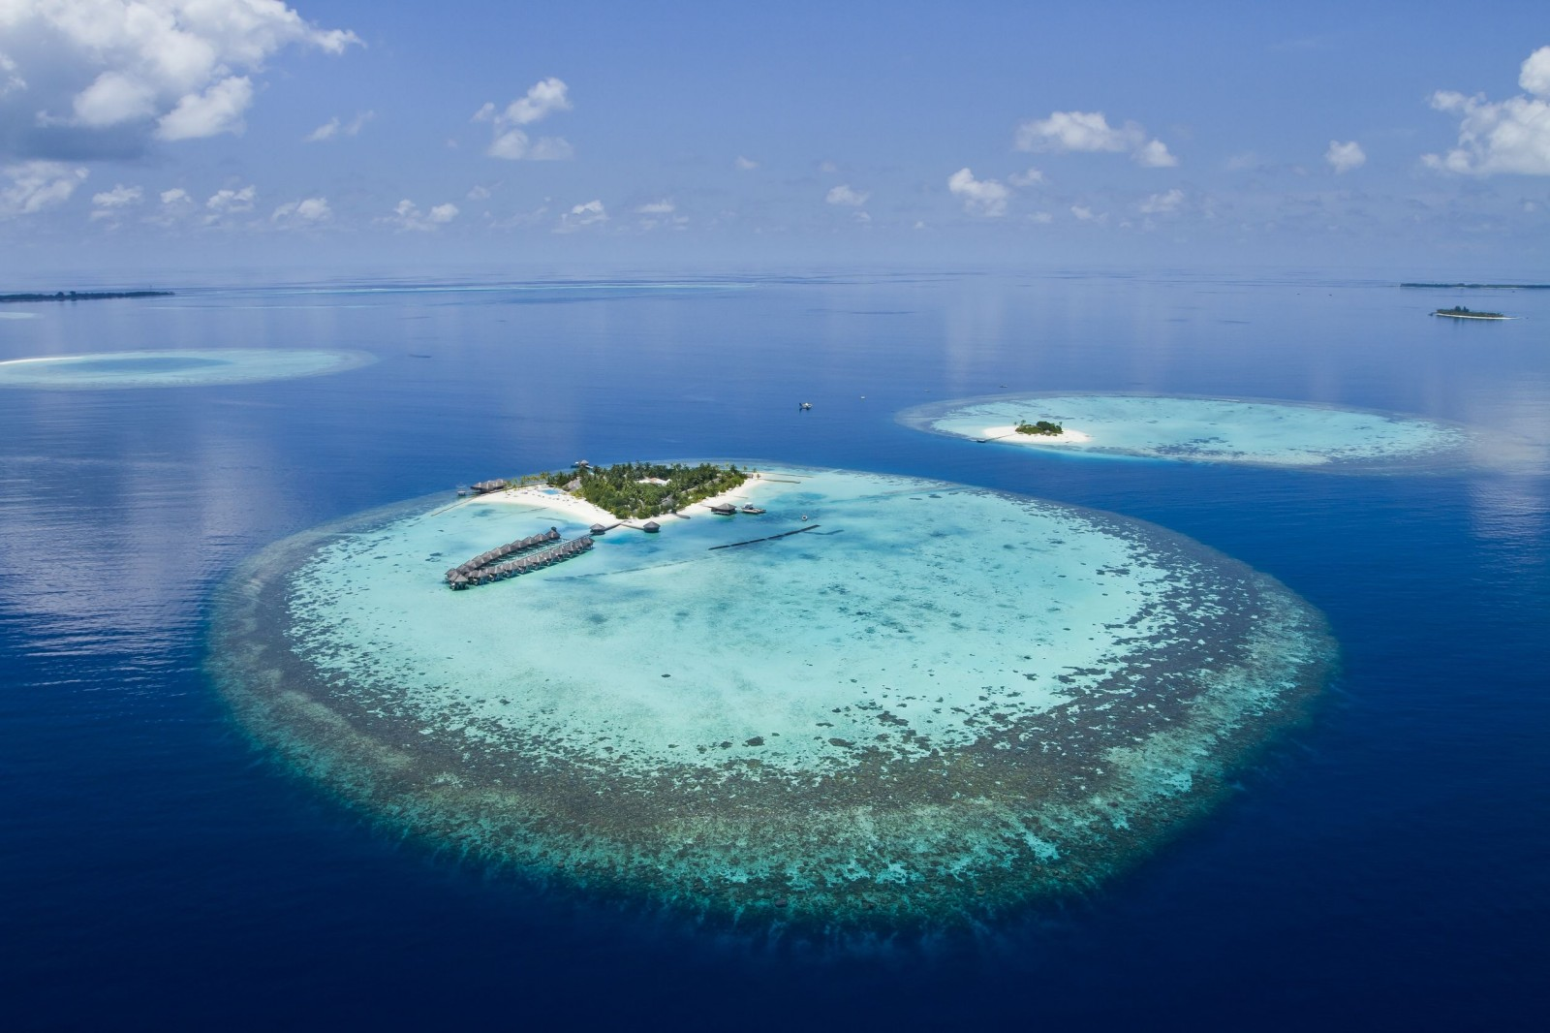

Slide 7
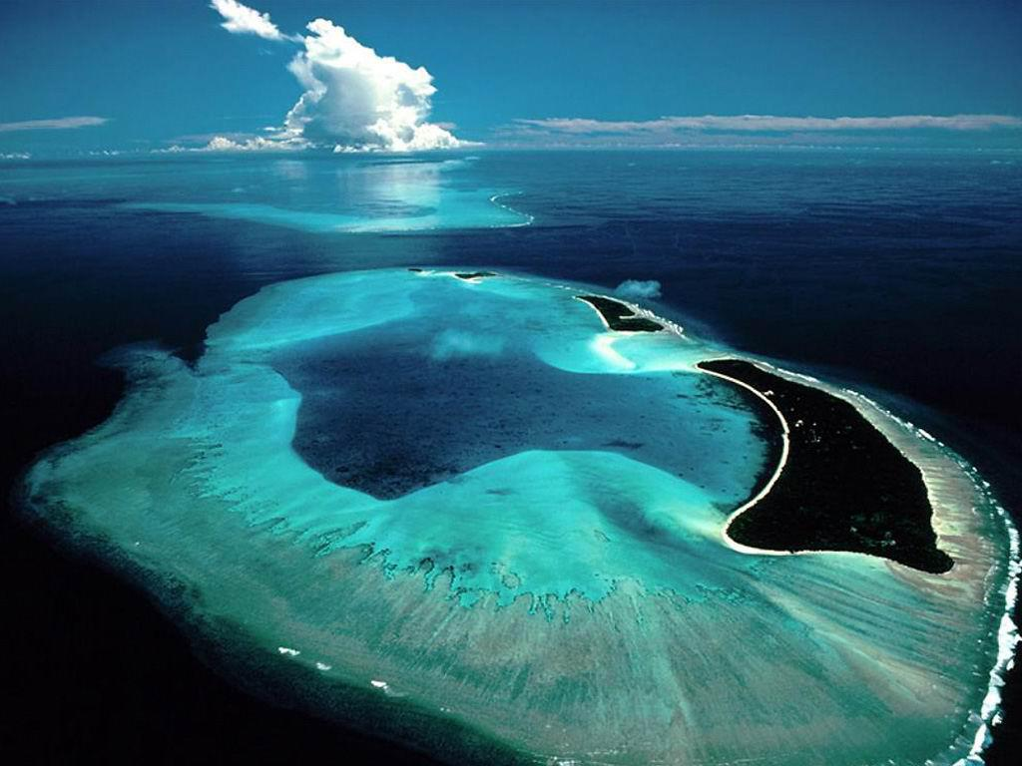

Slide 8
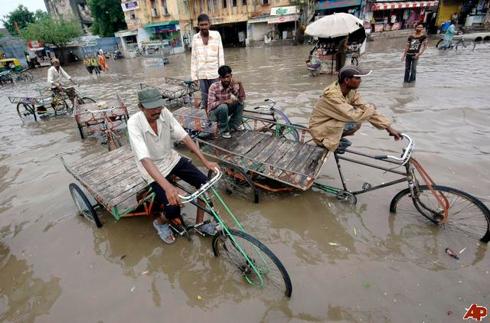
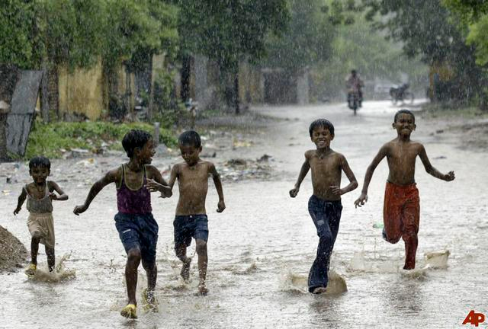
Monsoons:
Seasonal winds
  From June through September, monsoon winds bring heavy rainfall

Slide 9
Cyclone:
A violent storm with fierce winds and heavy rain
  Severe cyclones can cause major damage and death

Slide 10
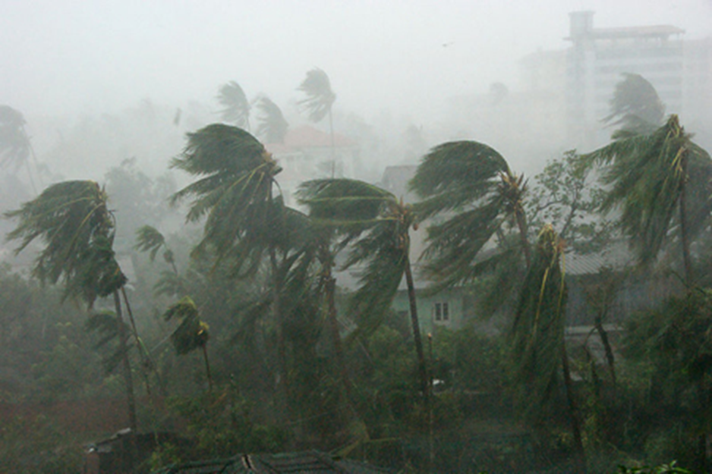
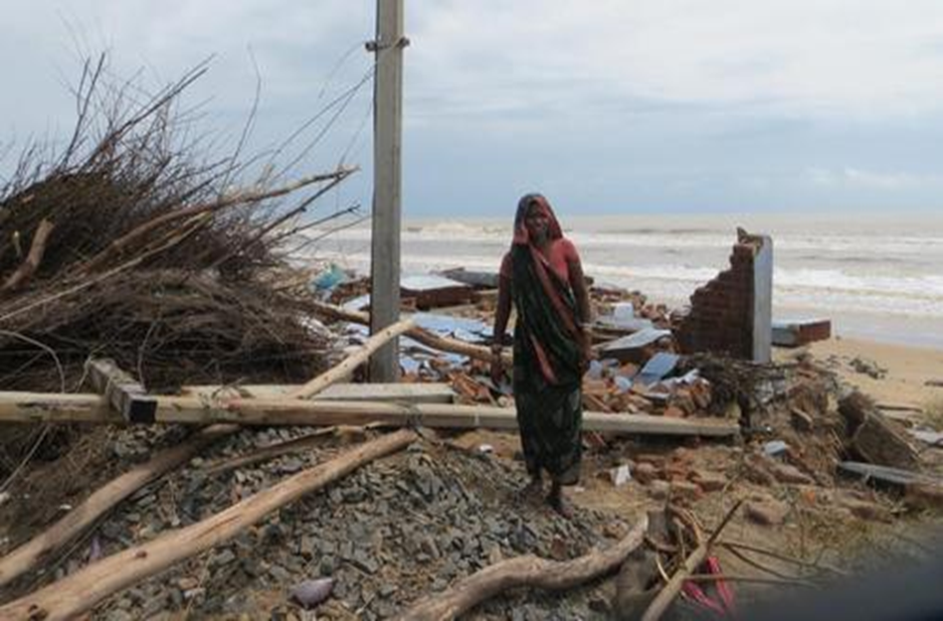

Slide 11
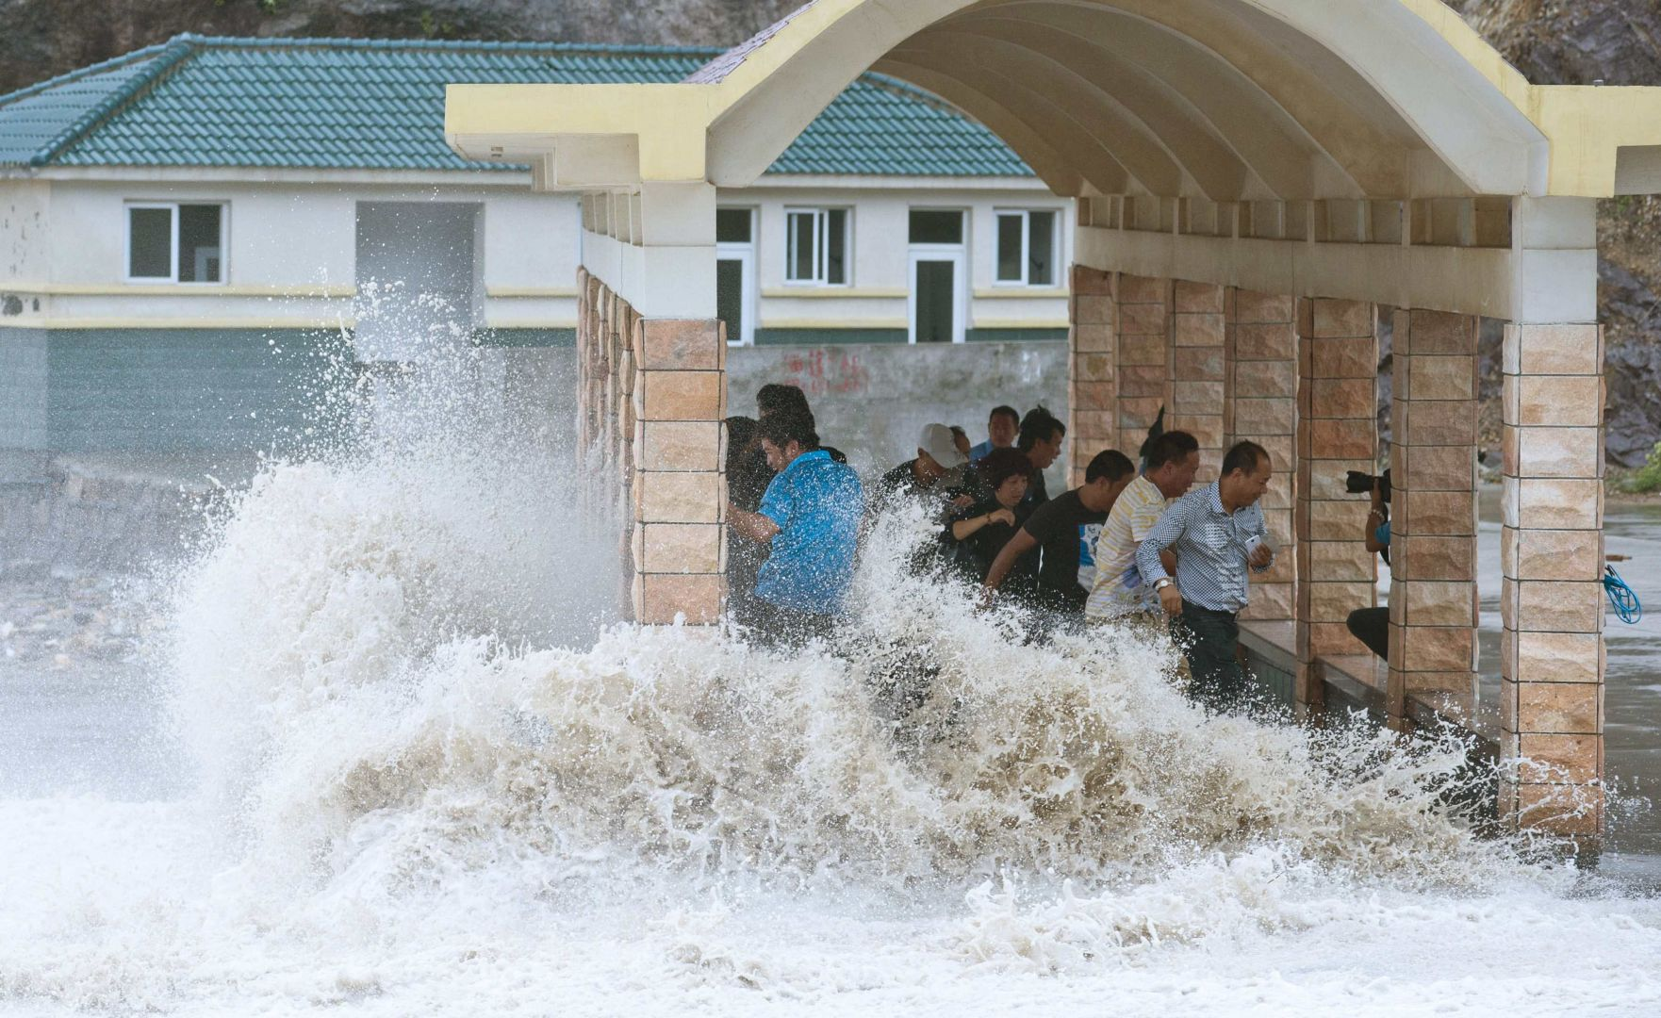
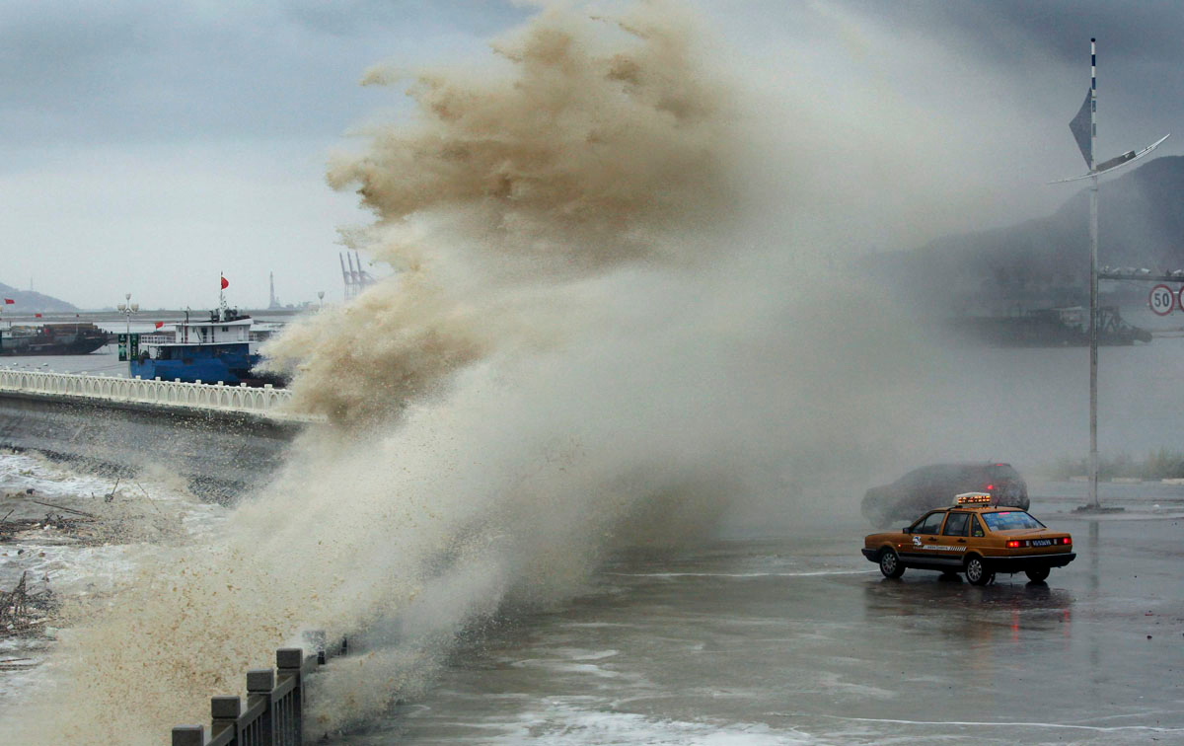
Storm Surge:
High water levels brought by a cyclone that swamps low-lying areas

Slide 12
Estuary:
A broadened end of a river where the river’s currents meet the ocean tide

Slide 13
